Slide 1
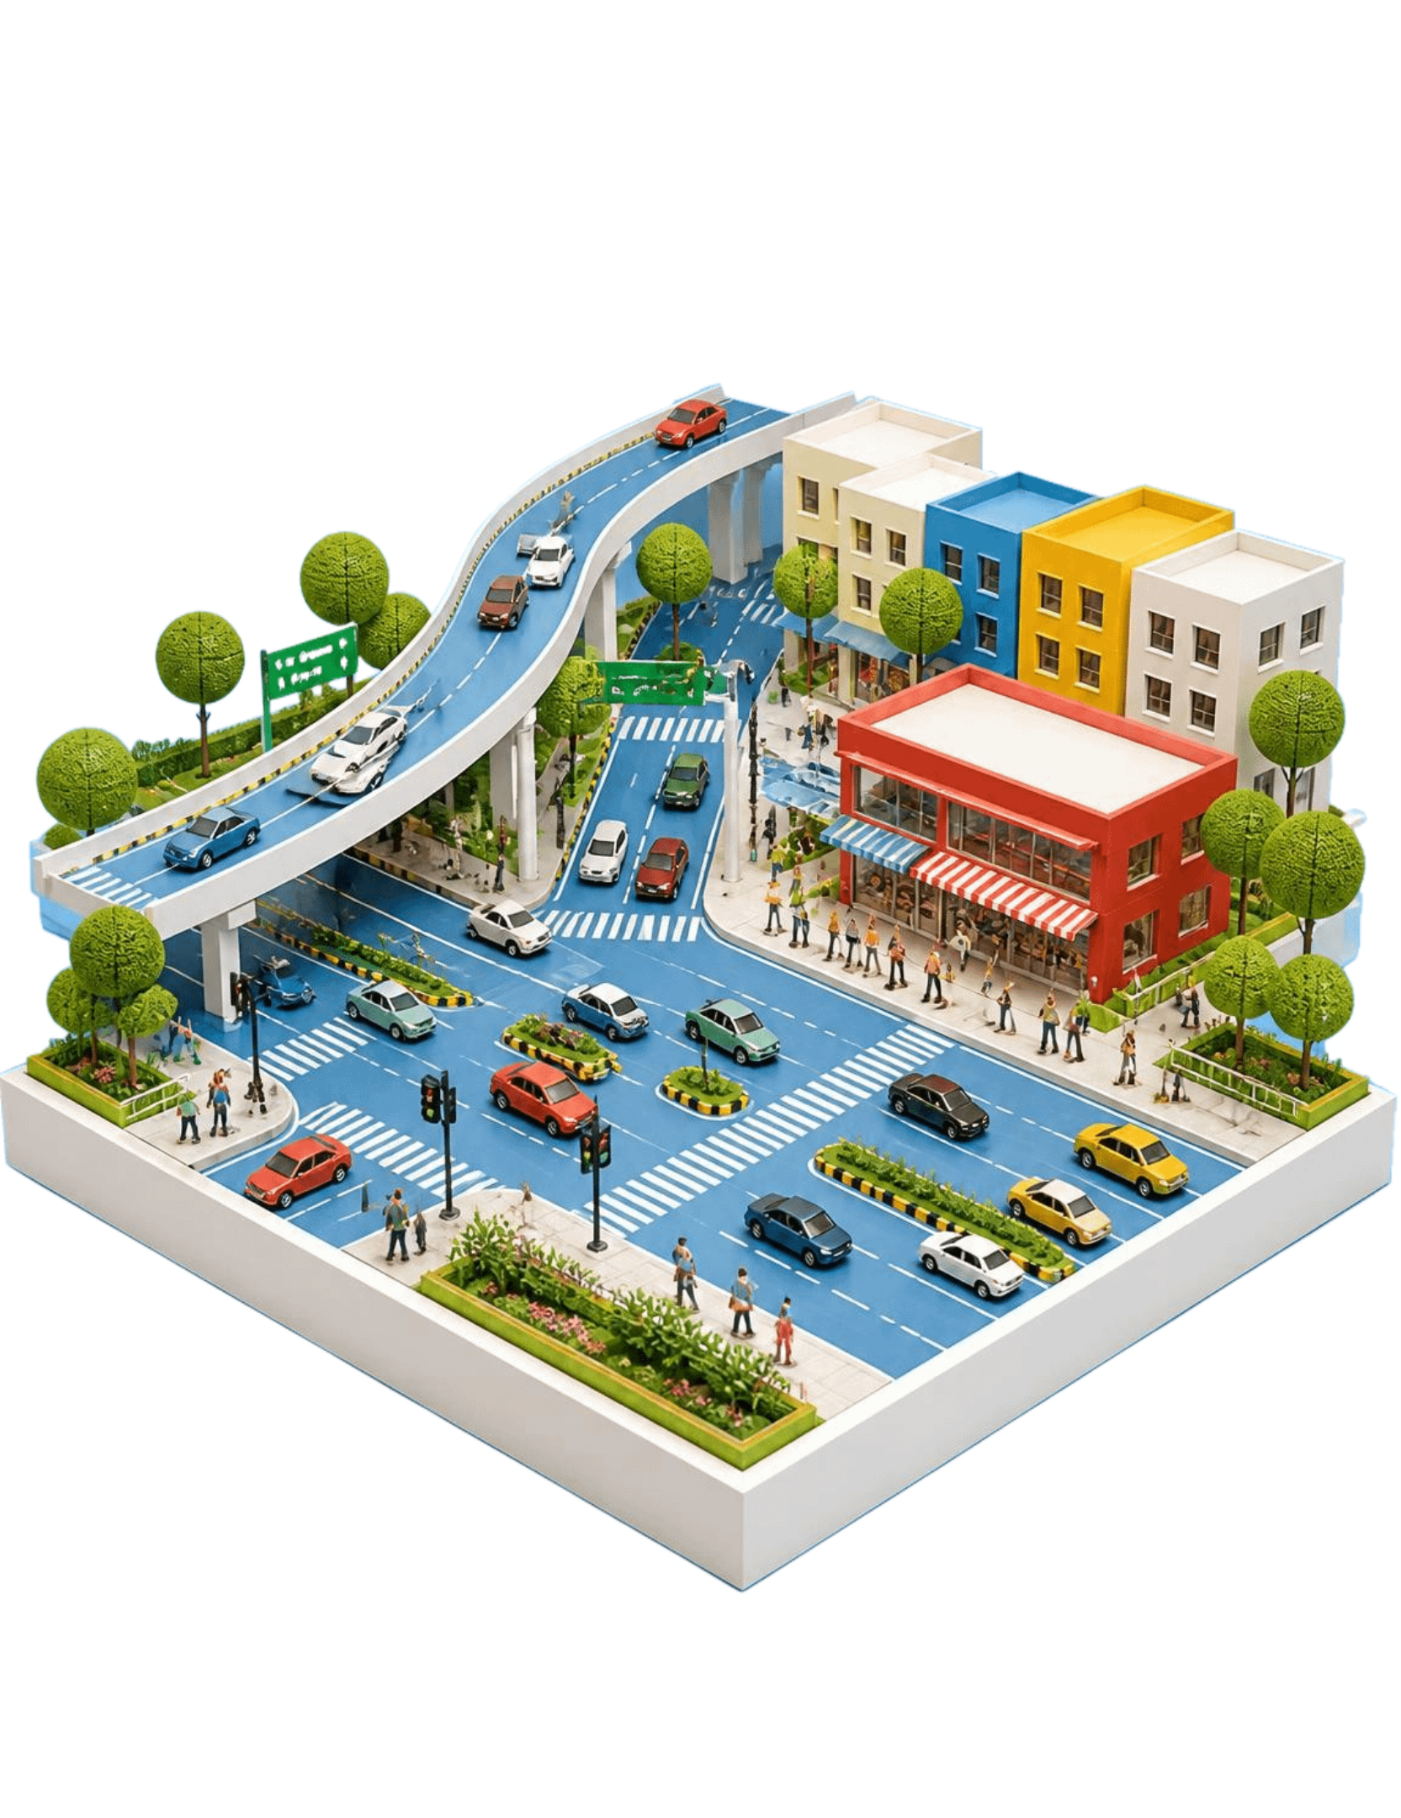
DESIGN THINKING HUM_4342
Urban Health Monitoring System: Phase 2
Mentors: Dr. Arun Y Patil and Dr. Vandana Jha, Associate Professors, Manipal Institute of Technology Bengaluru, MAHE, Manipal
Name | Registration No.
Uday Banerjee | 235816336
Aayush Sharda | 235890136

Slide 2
Contents
Introduction
2
Patent search, publication search and product search
1
3
Empathize phase: customer journey mapping
Define the problem statement
4
5
Analyze phase: 5-Whys and How might we
Action plan for Phase 3
6

Slide 3
Phase 1 showed that city health problems surface after the harm is done
RECAP
GAPS
Urbanization, pollution and outbreak risk strain city health systems.
Siloed data, delayed reporting, low sensor coverage, no predictive view.
STAKEHOLDERS
PROPOSED SCOPE
City government, hospitals and clinics, environmental agencies, residents.
Air quality, water quality, noise levels, disease surveillance.

Slide 4





Findings: data is fragmented, reactive and uneven, yet stakeholders want one real-time view
Fragmented
Reactive
Health and environment data sit in separate systems.
Alerts follow incidents.
Uneven
High demand
Coverage varies sharply by district.
Every stakeholder group asked for one shared view.
Risks carried forward
Data privacy, sensor cost, system integration, public trust.

Slide 5
3Ps: patent, publication and product search
PATENTS
PUBLICATIONS
PRODUCTS
[CN209878127U — Urban environmental noise monitoring device based on wireless sensor network]
[Relevant precedent for attaching distributed monitoring nodes to urban infrastructure and transmitting measurements remotely.]
[Guha & Gokhale (2023) — Urban workers' cardiovascular health due to exposure to traffic-originated PM2.5 and noise pollution]
[Provides health-oriented justification for considering PM2.5 and noise together.]
[AtomSenses Smart City Solution / Multi-Parameter Urban Sensor]
[Demonstrates that multi-parameter sensing on distributed urban infrastructure is commercially feasible.]

Slide 6
3Ps: patent, publication and product search
PATENTS
PUBLICATIONS
PRODUCTS
[CN102506991B — Distributed urban environment noise real-time automatic monitoring system]
[Relevant precedent for distributed spatial monitoring, centralized analytics and map-based urban noise visualization.]
[Agarwal, Swami & Gupta (2009) — Development of a noise prediction model under interrupted traffic flow conditions: a case study for Jaipur city]
[Directly supports noise and honking as measurable stress-related variables at signalized intersections.]
[Polludrone — TechnoValue]
[Demonstrates a commercially available integrated environmental-monitoring approach close to the proposed sensor layer.]

Slide 7
3Ps: patent, publication and product search
PATENTS
PUBLICATIONS
PRODUCTS
[CN116205771B — Acoustic environment information system based on noise monitoring and prediction calibration]
[Especially relevant to the proposed integration of traffic, environmental context, prediction and spatial decision support.]
[Modelling traffic noise-induced annoyance at intersections and its association with psychological health (2025)]
[Most directly aligned with the project's stress concept and supports linking measurable intersection conditions with human-perceived effects.]
[iSenseAQ1000+ — Intermatic]
[Demonstrates practical co-location of air-quality and noise sensing with real-time connectivity.]
TAKEAWAY TO DRAW: WHERE EXISTING SOLUTIONS LEAVE THE PHASE 1 GAPS OPEN

Slide 8
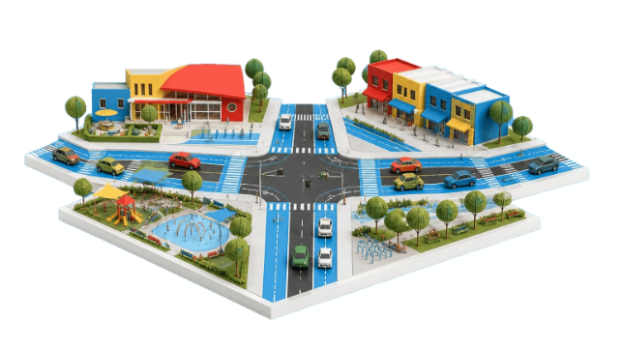
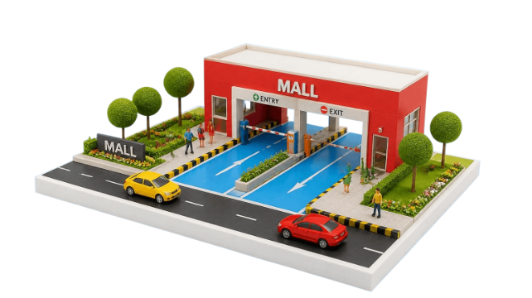
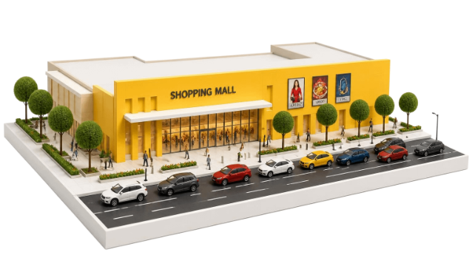
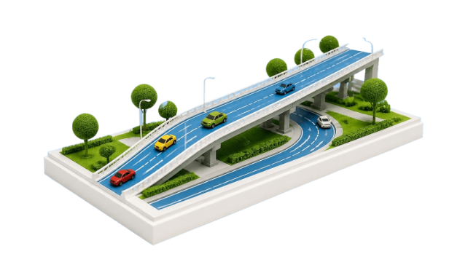
Four high-traffic locations near Manipal University suffer heavy traffic, noise and air pollution
1
2
3
4
Bagalur Cross
Phoenix Mall of Asia entry/exit gate, service road
Near Galleria Mall
Hebbal Flyover entry
Traffic · noise · air
Traffic · noise · air
Traffic · noise · air
Traffic · noise · air
SHARED PATTERN: HEAVY TRAFFIC FEEDS BOTH NOISE AND AIR POLLUTION

Slide 9
Empathize: a commuter's journey through the hotspots
 | Travel | Wait in traffic | Exposure | Symptoms | Response
Actions | Daily commute begins | Idles at the junction | Breathes fumes | Cough, headache | Closes windows, detours
Thoughts | "Same route again" | "When will this move?" | "The air feels heavy" | "Is this the traffic?" | "Nobody warns us"
Pain points | Noise | Fumes | No warning | Stress | No local data
Opportunities | Live exposure view | Route alerts | Local sensing | Early warning | Shared data
DAILY COMMUTER
NEARBY RESIDENT
ROADSIDE VENDOR
Cells are team hypotheses. [Team to confirm each observation on site.]

Slide 10
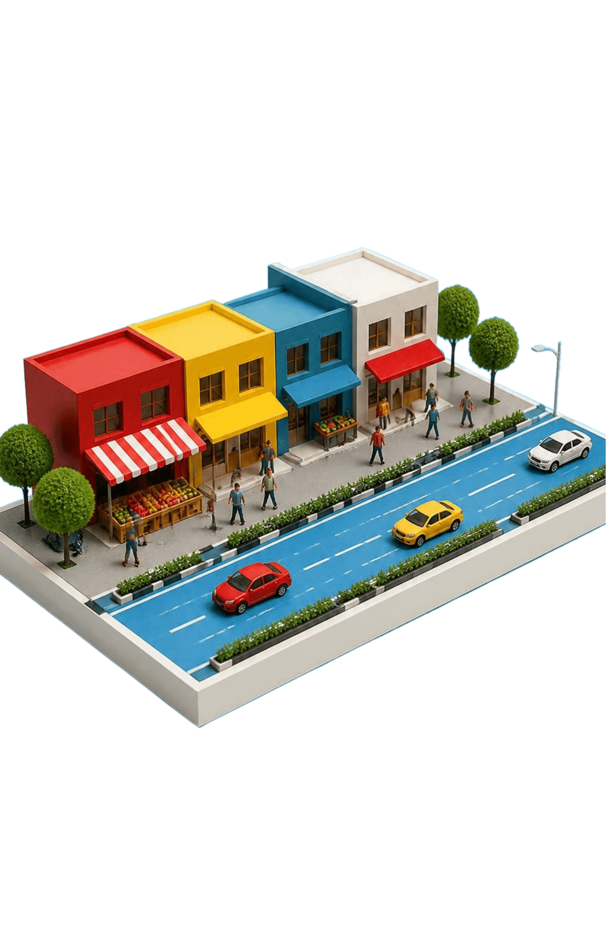
PROBLEM STATEMENT
Problem statement: people at traffic hotspots are exposed to pollution with no local, real-time warning
1
Who commuters, residents and workers near busy junctions
2
Need a shared, real-time view of air and noise exposure
3
Insight monitoring is sparse and reactive, so harm comes first

Slide 11
We used 5-Whys to trace the hotspot problem down to its root
1
Why are people near these junctions unwell or stressed? They are exposed to high air and noise pollution.
2
Why is exposure high? Heavy, slow and idling traffic concentrates at these points.
3
Why does traffic concentrate there? Mall gates, a flyover entry and a cross merge flows with little traffic management.
4
Why is nobody acting on it? There is no local, continuous measurement to show how bad it is.
5
Why is there none? Monitoring is sparse, siloed across agencies and reactive. Root cause.

Slide 12
What the 5-Whys approach did for us
SHIFT
CONFIRMED
Moved us from the symptom (pollution) to a systems cause (no connected, real-time monitoring).
The Phase 1 gaps: siloed data, low coverage, no predictive view.
DIRECTION
LIMITS
Pointed the solution at sensing and sharing, not only at reducing traffic.
The chain rests on observation, so on-site readings must validate it.

